Slide 1

Prediction of Arrhythmia After Acute Myocardial Infarction Using Machine Learning and Statistical Analysis Techniques
Presented By
Supervised By
Dr. Uzzal Biswas
Associated Professor
Salauddin Tapu
Student ID: 180923
External Member
Ummay Umama Gronthy
Student ID: 180939
Dr. Abdullah-Al Nahid
Professor
Electronics and Communication Engineering (ECE) Discipline
Khulna University
Khulna, Bangladesh
February 2023

Slide 2

Presentation Outline
Literature
Review
Materials
and Method
Results and
Discussion
Introduction
Conclusion

Slide 3
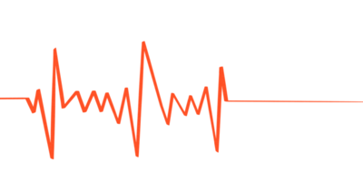


What is Arrhythmia?
Any irregular heart rhythms
Figure 1: Arrhythmia patient

Slide 4
Background
Morbidity
Hospitalization
Economic losses
Mortality

Slide 5






Motivation
Early detection and
on-time prediction
Life threatening condition
High cost
Various clinical tests
Time latency
Clinical data analysis

Slide 6
Objectives
1
To identify important features for predicting arrhythmia
2
To reduce time complexity
3
To investigate the acute myocardial infraction (AMI) dataset
4
To analyze the model performance

Slide 7
Literature Review

Slide 8





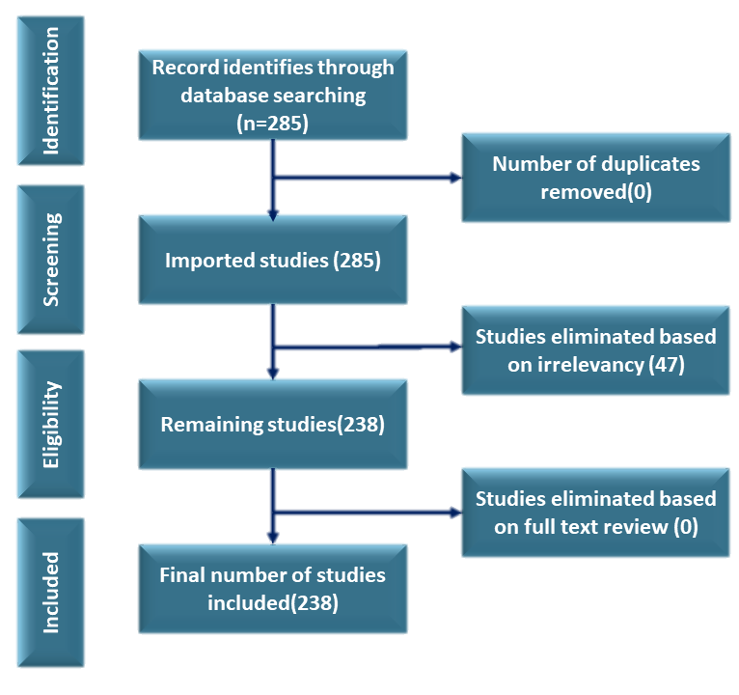






Overview of
Bibliometric Analysis
Web of Science
Relevancy
Networking
Discussion
Three Field plot
PRISMA
Trend
Thematic
Evaluation
Citation
Conclusion
Biblioshiny
Historiograph
Methods
Performance
Analysis
Science
Mapping
Discussion
and Conclusion

Slide 9
PRISMA Method
Identification
Record identifies through database searching
(285)
Number of duplicates removed (0)
Screening
Imported studies (285)
Studies eliminated based on irrelevancy (47)
Eligibility
Remaining studies (238)
Studies eliminated based on full text review (0)
Included
Final number of studies included (238)

Slide 10
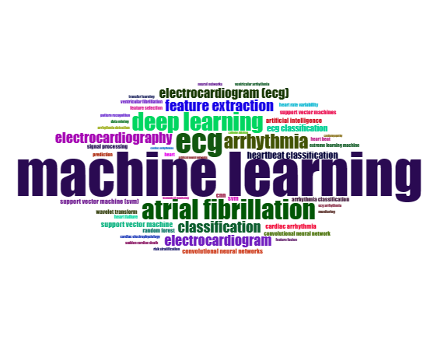
Word Cloud
Figure 2: Word cloud

Slide 11
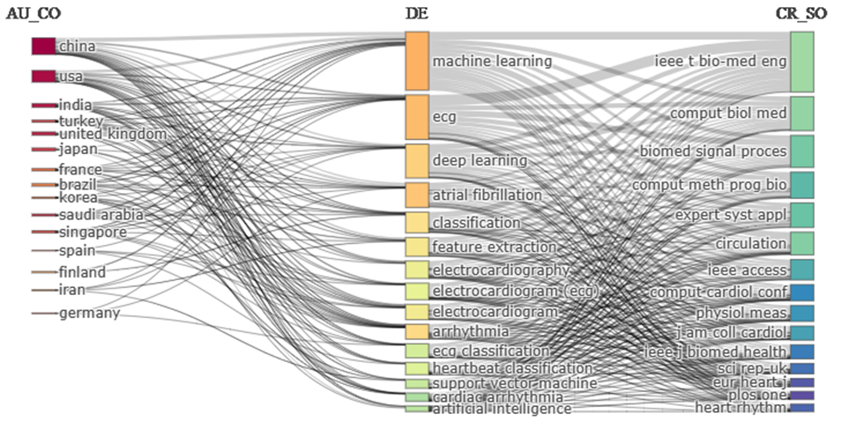
Three Field Plot
Country
Keyword
Source
Figure 3: Three field plot

Slide 12
Materials and Method

Slide 13
Materials and Method
AMI Dataset
Statistical Analysis
Machine Learning Analysis
Chi square test
Gamma coefficient
Crosstab analysis
Hyper parameter tuning
Model training
Prediction

Slide 14
Description of Dataset
Dataset Collected from
Harbin Medical University
Number of Subject
2086
Number of Features
45
Categories of Features
6

Slide 15
Categories of Feature
Demographics & Medical History
Baseline Characteristics of Admission
Laboratory Characteristics
Findings on ECG
Echocardiographic Parameters
Angiographic Characteristics

Slide 16
Chi-Square Test
p value
Figure 4: Determination of association

Slide 17
Gamma Coefficient Analysis
Moderate
Features association strength
Figure 5: Determination of association strength

Slide 18
Crosstab Analysis
Table 1: Categorical relationship analysis
Arrhythmia
Feature Name
Category (mm)
Yes
No
<40
40.30%
59.70%
RA (left and right)
≥40
67.10%
32.90%

Slide 19
Crosstab Analysis
Figure 6: Determination of association strength

Slide 20
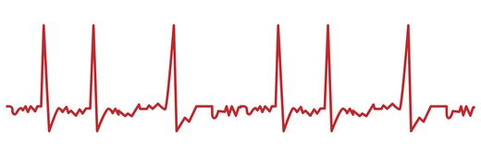
Machine Learning Analysis
Machine Learning Algorithm
Prediction
Arrhythmia

Slide 21
Methodology
Dataset
Data Preprocessing
Hyper Parameter Tuning
Feature Selection
Optimized Model
Performance Analysis

Slide 22



Data Preprocessing
Data
Preprocessing
Processed Dataset

Slide 23
Hyper Parameter Tuning
Random Forest
Algorithms
Grid Search CV (GS)
Random Search CV (RS)
Bayesian Optimization (BO)
Bayes Search CV (BS)
Optuna
Cuckoo Search Algorithm (CSA)
Max Depth
N Estimators
Min Samples Leaf
Max Features
Figure 7: Hyper parameters of random forest

Slide 24
Hyper Parameter Tuning
Table 2: Outcomes of the algorithms
Algorithm Name | Accuracy | Max Depth | Max Features | Min Samples Leaf | N Estimators
GS | 62.50% | 7 | 8 | 32 | 63
RS | 58.70% | 6 | 25 | 4 | 40
BO | 62.20% | - | 0.67 | - | 198
BS | 63.80% | 6 | 10 | 30 | 60
Optuna | 62.10% | 46 | sqrt | 24 | 70
CSA | 69.71% | 30 | 21 | 13 | 46

Slide 25

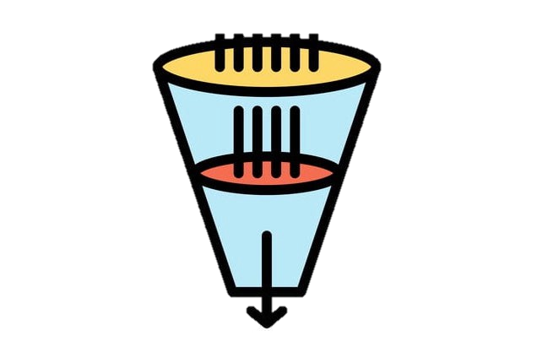
Feature Selection
Data
Features
Features Selection
Selected Features

Slide 26

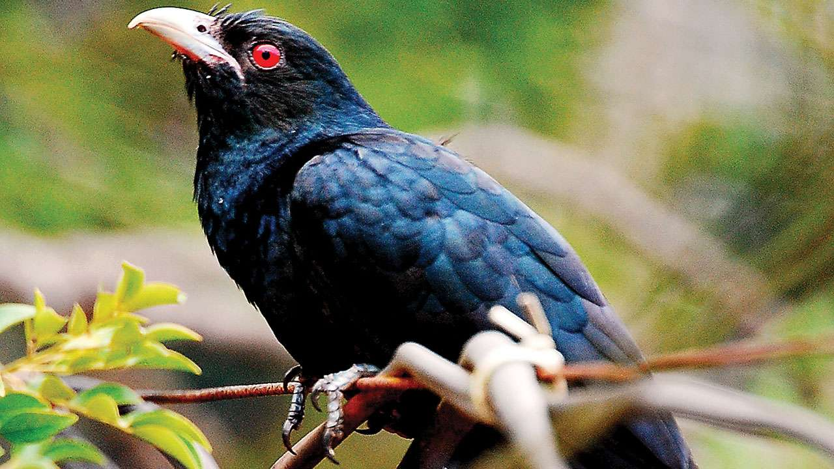

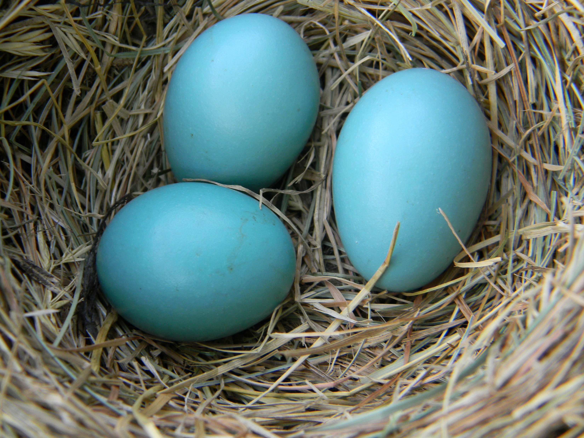


Feature Selection
CSA
New Nest
Destroyed Egg
Cuckoo
Host Nest
Egg
New Generation

Slide 27

Feature Selection
CSA
F
F’
F
F
F’
F
F’
F’
Search Space
F’
F
F
F’
F’
F
F’
F
F’
F
F
F’

Slide 28
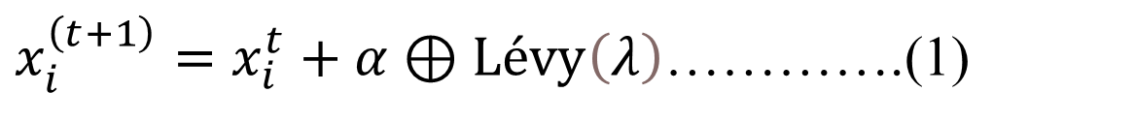
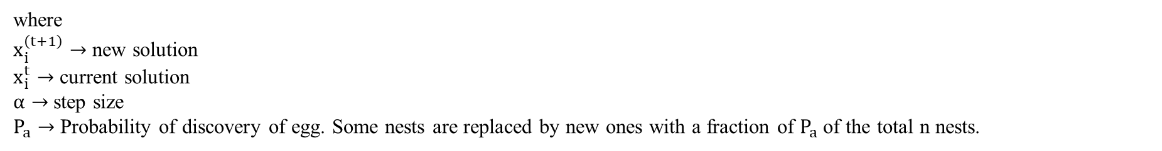
Feature Selection
Lévy Flight
$x_{i}^{\left(t+1\right)}=x_{i}^{t}+α⊕Lévy\left(λ\right)$………….(1)
where
$x_{i}^{\left(t+1\right)}→$ new solution
$x_{i}^{t}→$ current solution
$α→$ step size
$P_{a}→$ Probability of discovery of egg. Some nests are replaced by new ones with a fraction of $P_{a}$ of the total n nests.
Lévy distribution
$Lévy\sim u=t^{−λ}$…………………….......(2)

Slide 29
Model
Random Forest (RF)
Figure 8: Random decision tree

Slide 30

Model
Dataset
DT 1
DT 2
DT (n-1)
DT n
Result 1
Result 2
Result (n-1)
Result n
DT $→$ Decision Tree
Majority Voting/Averaging
Result
Figure 9: Random forest classifier

Slide 31
Result & Discussion

Slide 32
Model Training
AMI Dataset
All Features
Selected Features
Training RF
Training RF
Optimized Model
Unoptimized Model
Optimized Model

Slide 33
Feature Selection Outcome
Table 3: Feature selection outcome
Probability of Discovery of Egg | Returned Features | Feature Set
0.21 | Heart Beats, DD-P | 1
0.22 | DBP, RA (right and left) | 2
0.23 | DBP, DD-P | 3
0.24 | P-R, BBB | 4
0.25 | RA (right and left), PCI | 5
0.26 | E/A, BBB | 6
0.27 | Heart Beats, E/A, LVEDD, RA (right and left), BBB | 7
0.28 | Ventricular Wall Motion Abnormal, PCI, BBB | 8
0.29 | SBP, P-R | 9
0.3 | Heart Beats, Pre-diabetes Mellitus, BBB | 10

Slide 34
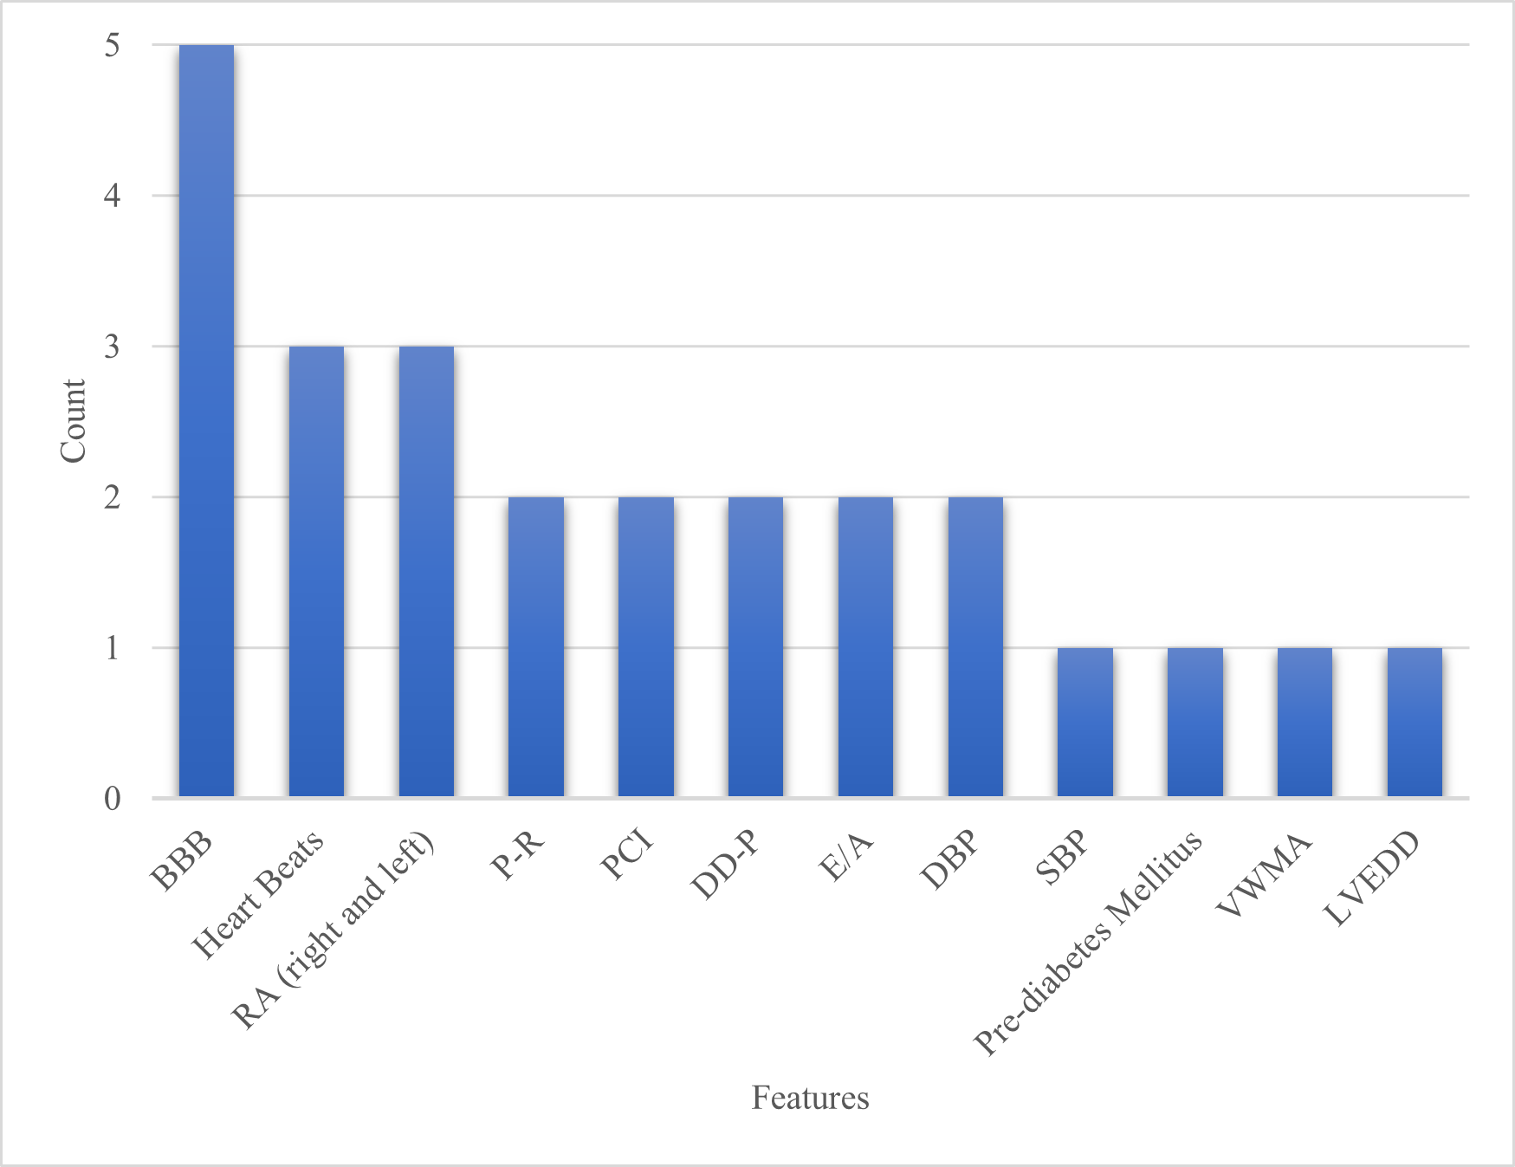
Feature Selection Outcome
Most Returned Features Set
BBB
Heart Beats
RA (right and left)
Features Returned from Statistical Analysis
P-R
BBB
RA (right and left)
RA (up and down)
Figure 10: Most returned features from CSA

Slide 35
Model Performance
Comparison
Table 4: Performance of models trained with different sets of features
Feature Set | Model | Accuracy | Precision | Recall | F - score
All Features | Unoptimized | 66.34% | 67.67% | 66.34% | 62.59%
All Features | Optimized | 69.71% | 72.96% | 69.71% | 66.21%
1 | Optimized | 68.89% | 70% | 68.89% | 66.25%
A | Optimized | 67.46% | 67.43% | 67.46% | 65.43%
B | Optimized | 65.55% | 67.47% | 65.55% | 60.76%
1 $→$ Feature Set 1 [Heart Beats, DD-P]
A $→$ Most Returned Features [BBB, Heart Beats, RA(right & left)
B $→$ Features Returned from Statistical Analysis [P-R, BBB, RA(right & left)]

Slide 36
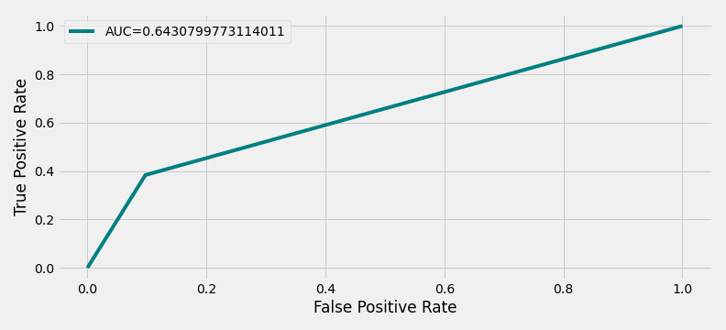
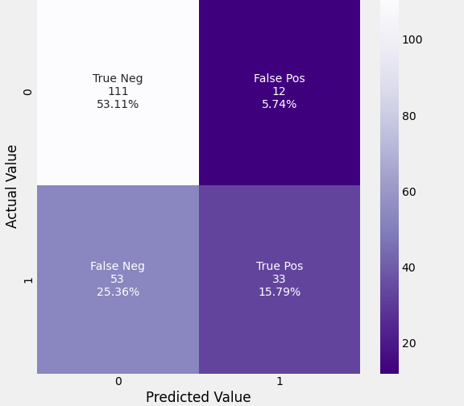
Result of Best
Performed Model
Figure 11: ROC curve of best performed model
Figure 12: Confusion matrix of best performed model

Slide 37
Comparison with
Previous Works
Table 5: Comparison with previous works
Work | Classifier | Dataset | Accuracy | F1 Score
[1] | RF | A | 94.65% | -
[2] | RF | B | - | 97.70%
[3] | RF | C | 98.90% | -
[4] | RF/ANN | AMI Dataset | 66.80% | -
Our | RF | AMI Dataset | 68.89% | 66.25%
A $→$ Clinical Dataset of Children Undergoing Interventional Closure of ASD at the Heart Center of Qingdao Women and Children’s Hospital
B $→$ Physionet/Computing in Cardiology 2017 AF Challenge dataset and the Atrial Fibrillation Termination Database (AFTDB). The test datasets consist of the MIT-BIH Atrial Fibrillation Database (AFDB) and the MIT-BIH Arrhythmia Database (MITDB).
C $→$ECG, PPG, and accelerometry measurements in 40 patients undergoing a 24-hour Holter measurement as part of routine clinical care.

Slide 38
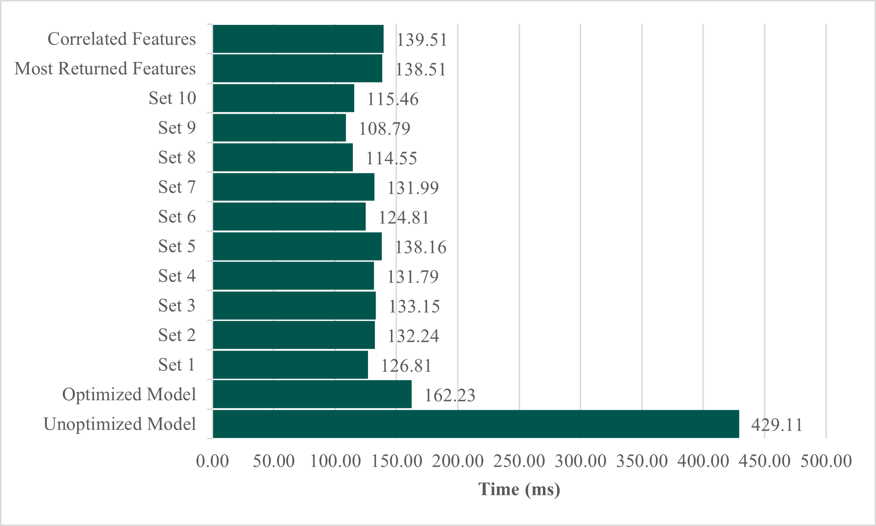
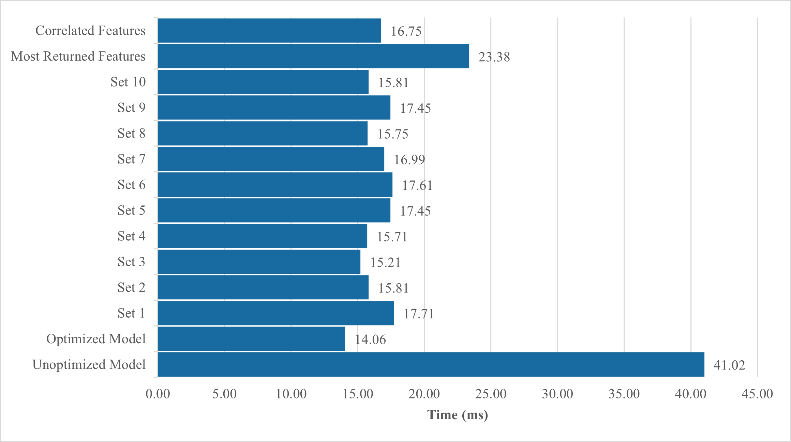
Time Complexity
Figure 13: Average training time
Figure 14: Average test time
PC running Windows 10 Home Single Language having Intel Core i3-7020U CPU processor with clock speed 2.30 GHz and 20 GB of RAM.

Slide 39
Conclusion & Future Work

Slide 40
Final Outcome
Improved the accuracy of model [68.89%].
Extracted important features for predicting arrhythmia
Reduced time complexity.

Slide 41
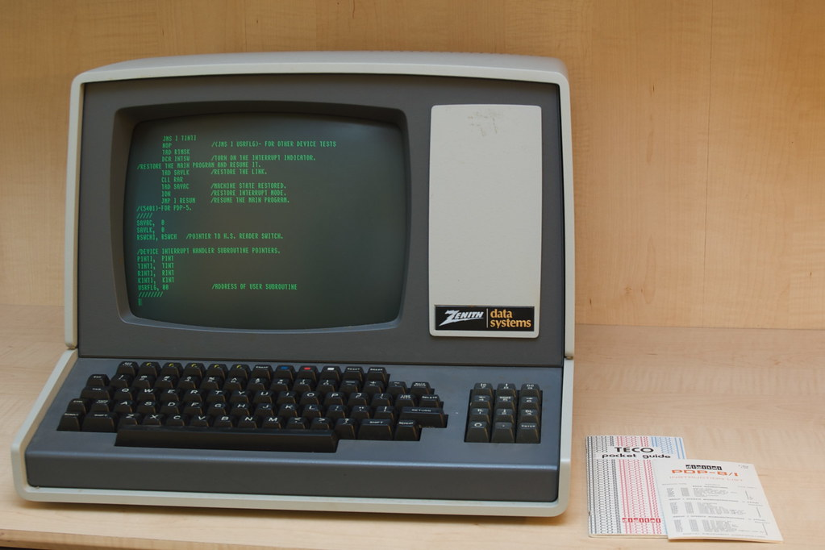

Limitations

Slide 42
Future Work
The model will be trained with other datasets.
Neural networks will be applied to improve the accuracy.
Real-time patient monitoring system will be developed

Slide 43
https://github.com/anaklusmos666/Thesis_Codes

Slide 44
Reference
[1] H. Sun, Y. Liu, B. Song, X. Cui, G. Luo, and S. Pan, "Prediction of arrhythmia after intervention in children with atrial septal defect based on random forest," BMC pediatrics, vol. 21, no. 1, p. 280, 2021.
[2] V. Kalidas and L. S. Tamil, "Detection of atrial fibrillation using discrete-state Markov models and Random Forests," Computers in biology and medicine, vol. 113, p. 103386, 2019.
[3] L. M. Eerikäinen et al., "Detecting atrial fibrillation and atrial flutter in daily life using photoplethysmography data," IEEE journal of biomedical and health informatics, vol. 24, no. 6, pp. 1610-1618, 2019.
[4] S. Wang et al., "Application of machine learning to predict the occurrence of arrhythmia after acute myocardial infarction," BMC medical informatics and decision making, vol. 21, pp. 1-14, 2021.

Slide 45
Acknowledgement
Thanks to our supervisor, Dr. Uzzal Biswas for his guidance and assistance
Also thanks to our external member, Dr. Abdullah-Al Nahid for his support and advice.
We are grateful to all the faculty members of Electronics and Communication Engineering Discipline of Khulna University.

Slide 46
Thank You

